Slide 1
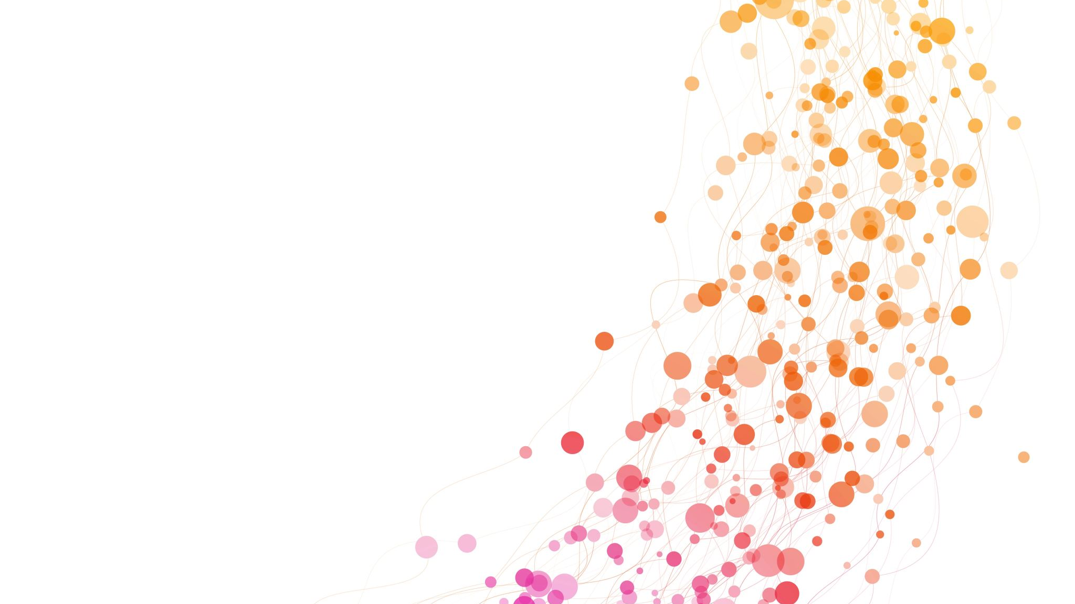
Boltzmann Machines

Slide 2
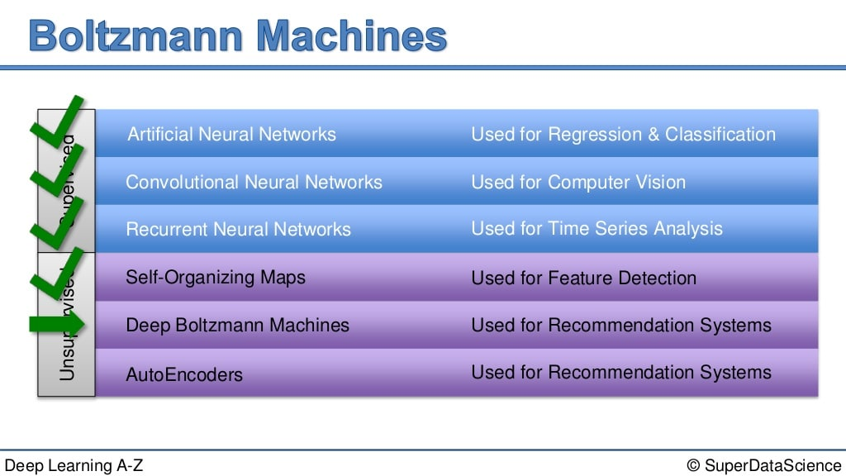

Slide 3
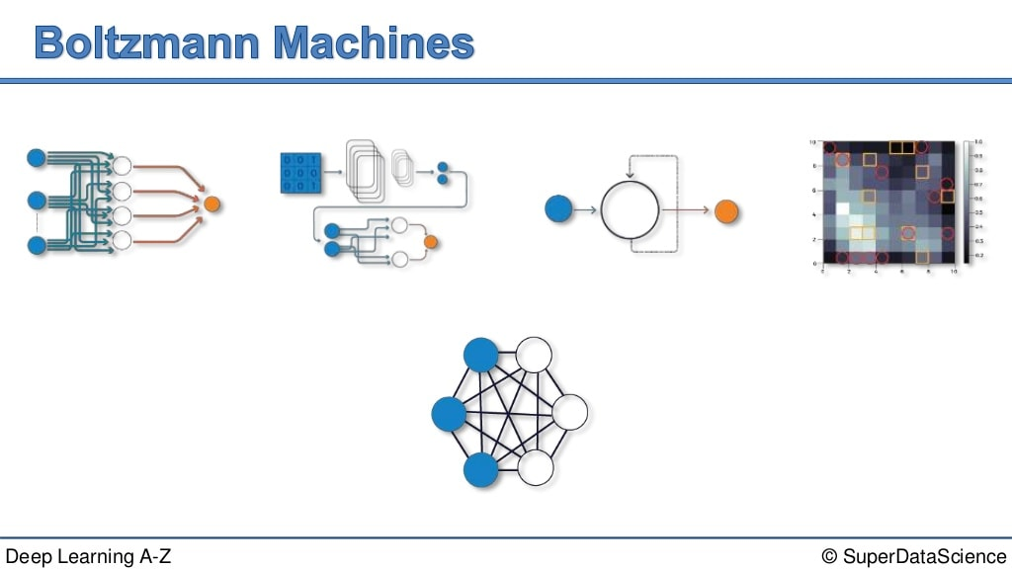

Slide 4
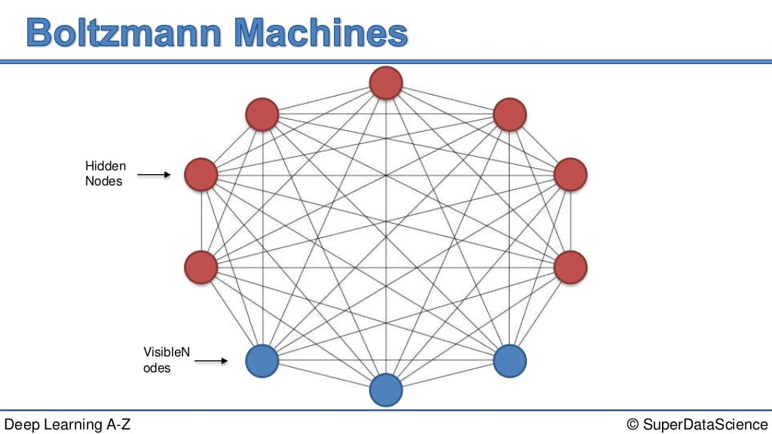

Slide 5
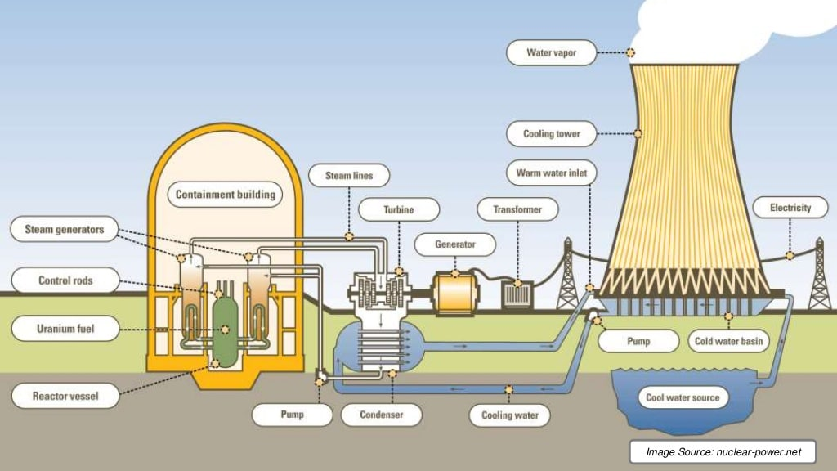

Slide 7
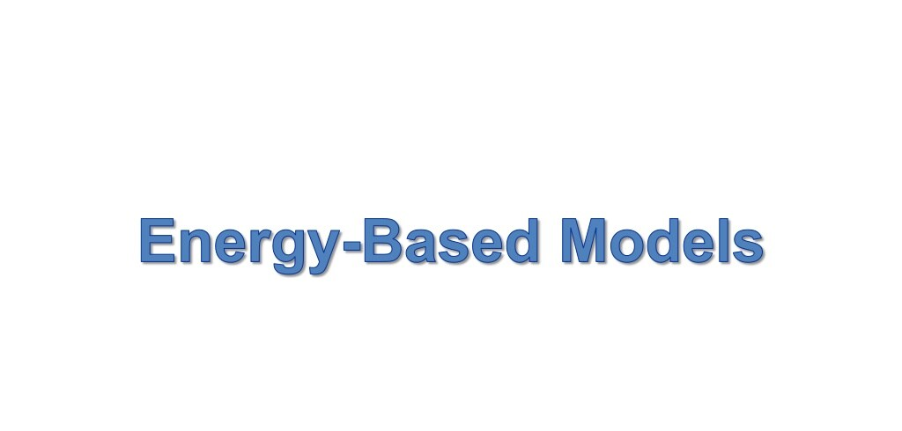

Slide 8
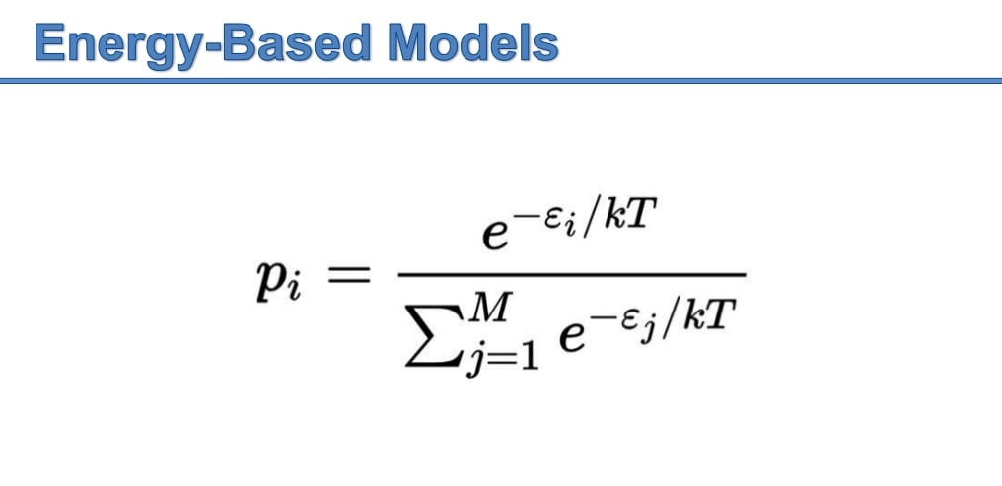

Slide 9
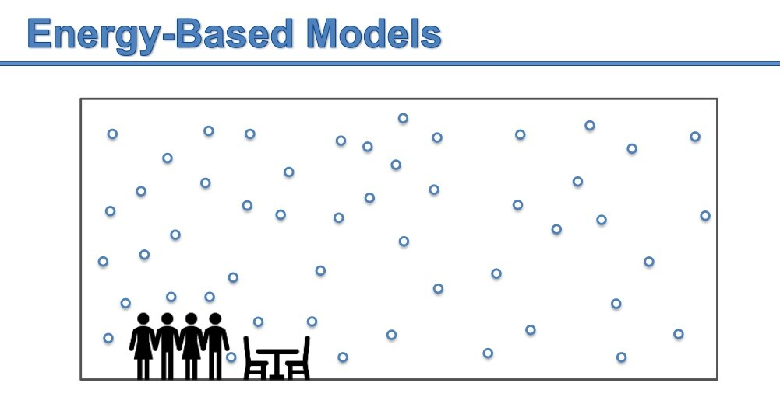

Slide 10
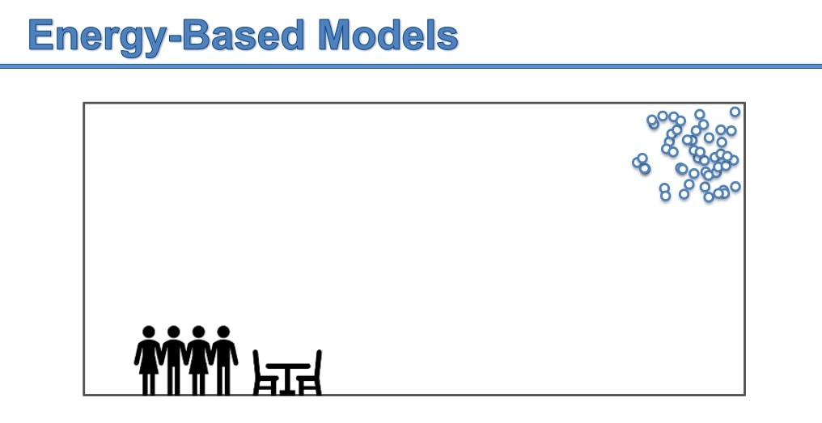

Slide 11
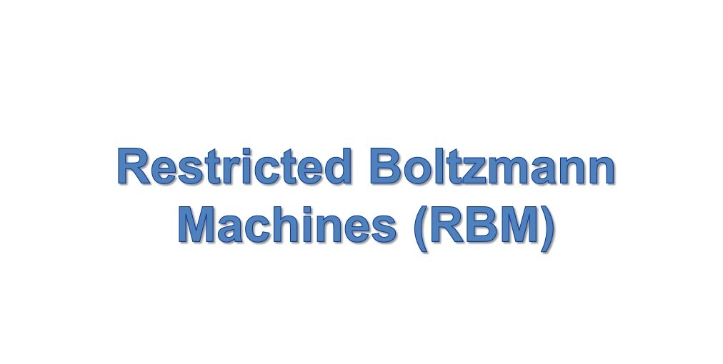

Slide 12
Applications
Restricted Boltzmann Machine algorithm plays an important role in dimensionality reduction, classification, regression and many more which is used for feature selection and feature extraction.
It is an algorithm which is useful for collaborative filtering and topic modeling.

Slide 14
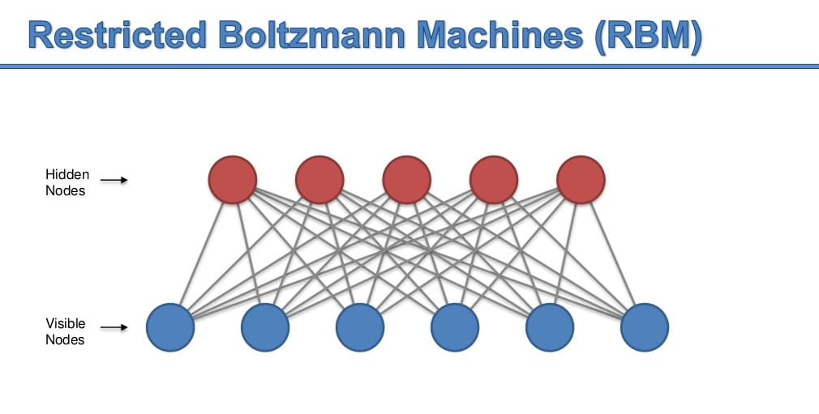

Slide 15
Explanation
Restricted Boltzmann Machines are shallow, two-layer neural nets that constitute the building blocks of deep-belief networks.
The first layer of the RBM is called the visible, or input layer, and the second is the hidden layer.
Each circle represents a neuron-like unit called a node.
The nodes are connected to each other across layers, but no two nodes of the same layer are linked.

Slide 16


Slide 17
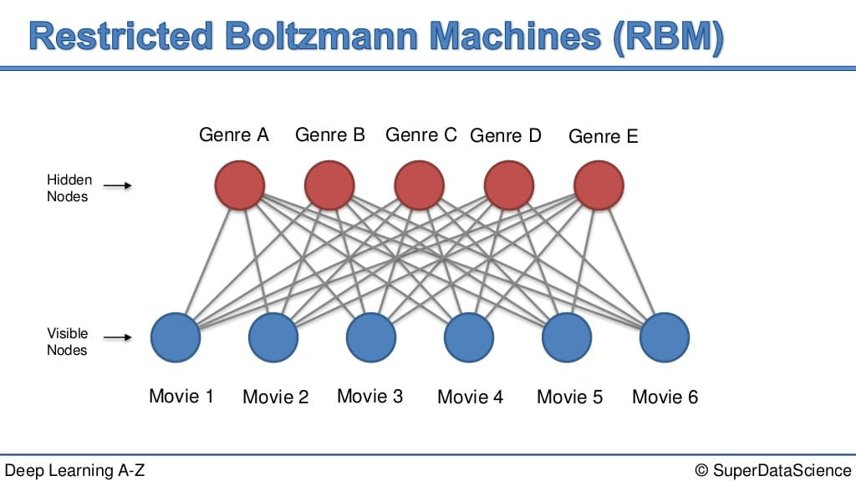

Slide 18
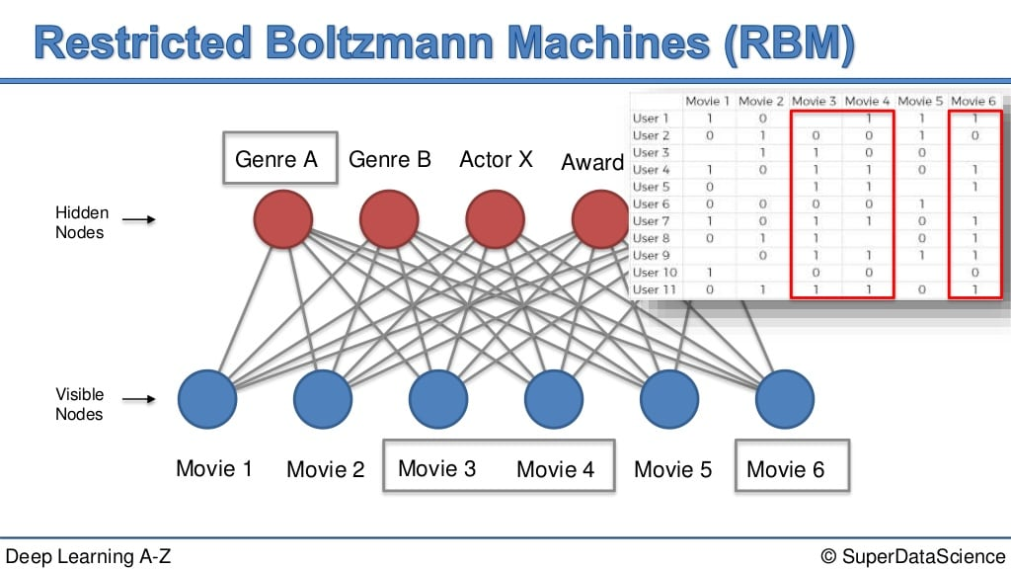

Slide 19


Slide 20
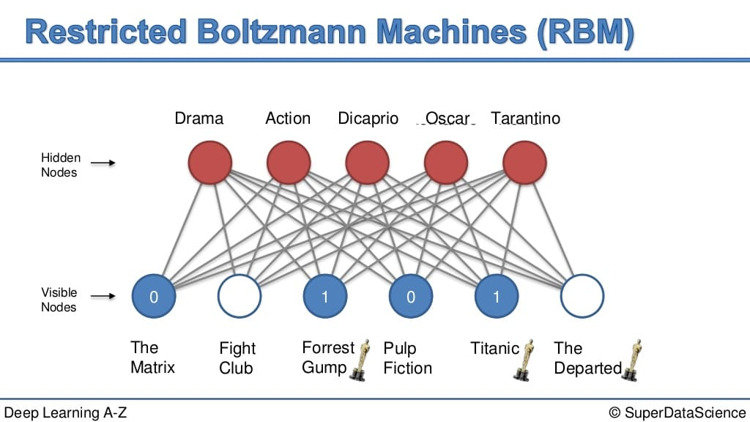

Slide 21
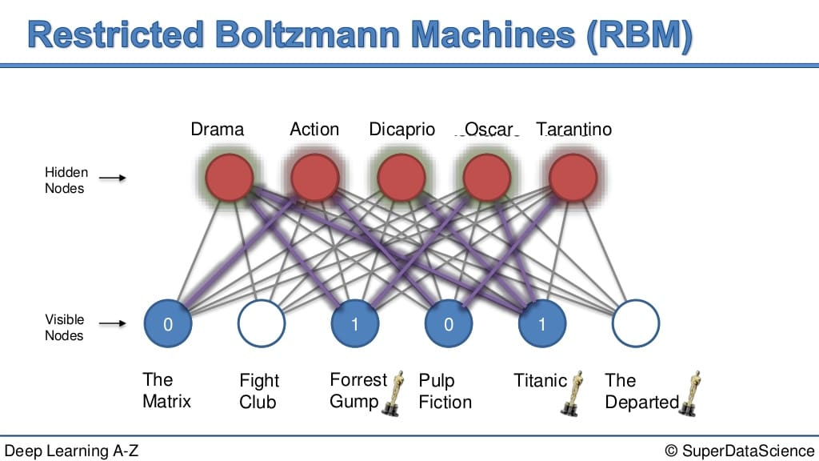

Slide 22
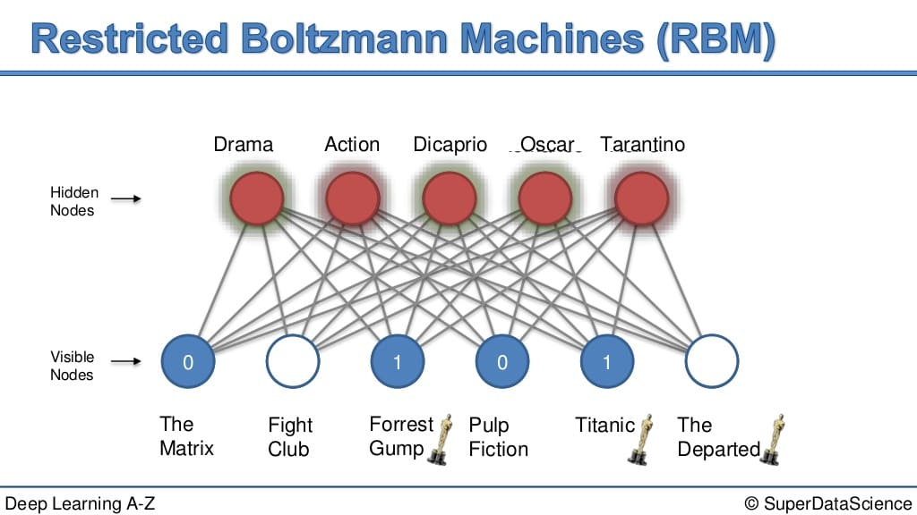

Slide 23
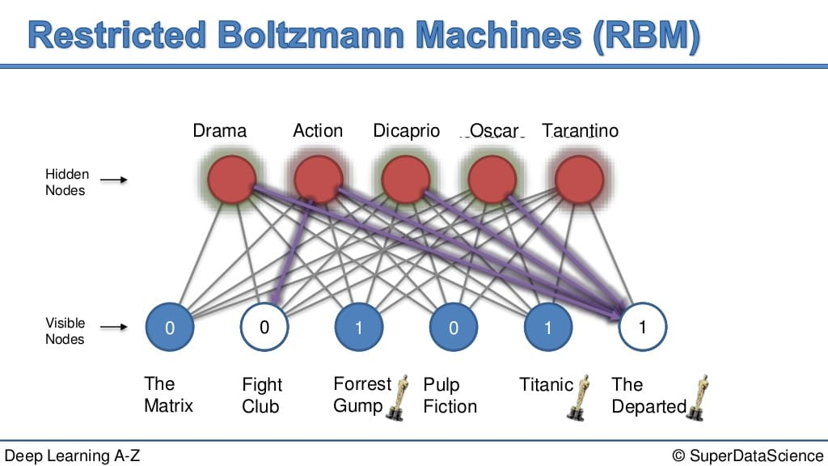

Slide 24
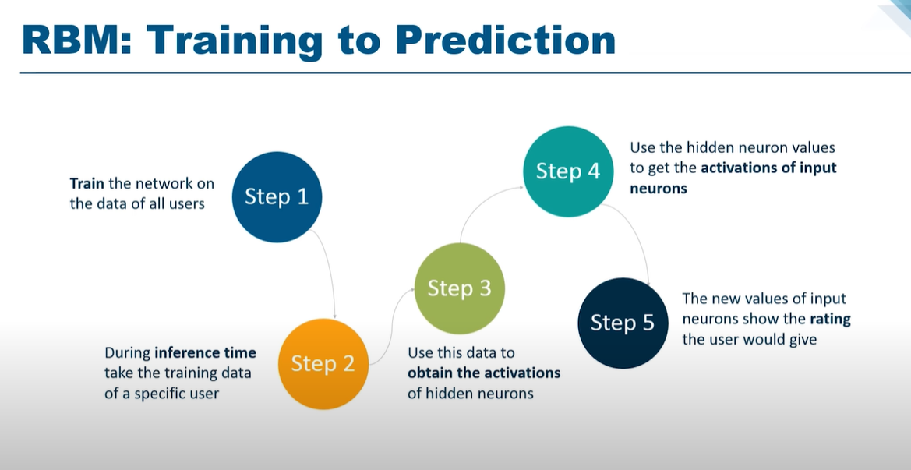

Slide 25
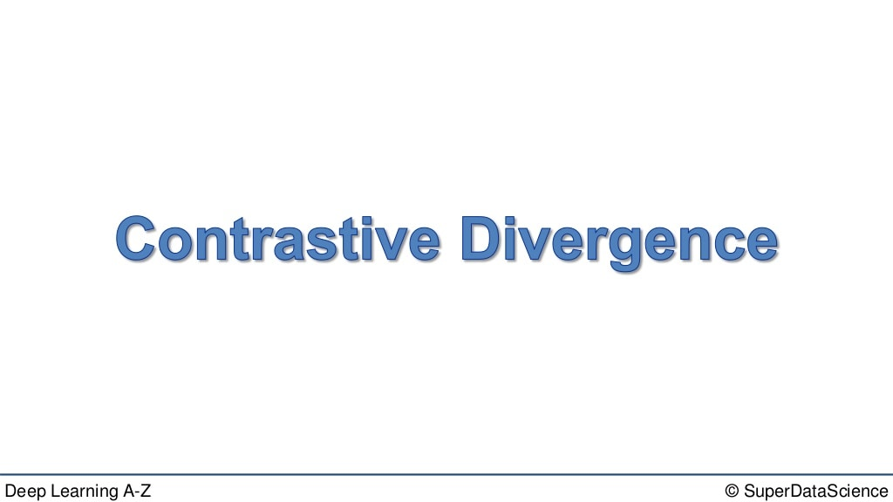

Slide 26
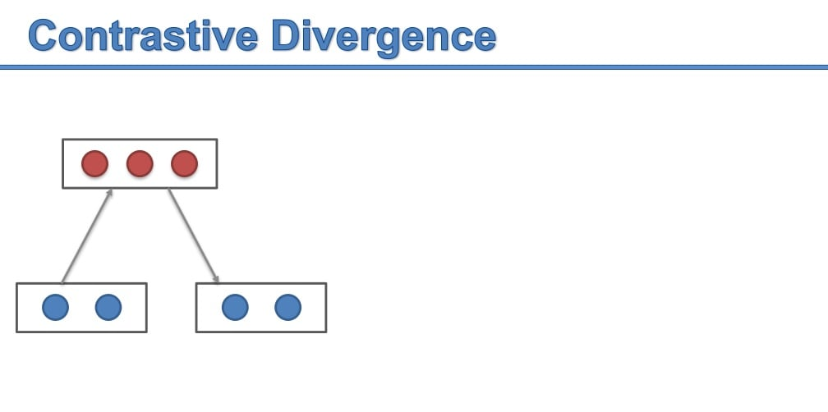

Slide 27
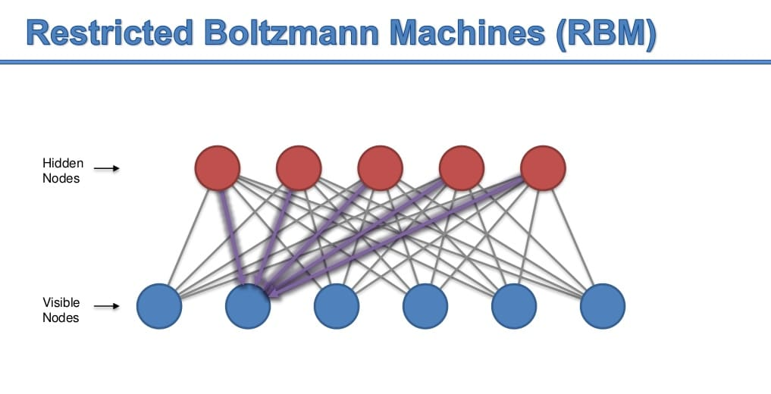

Slide 28
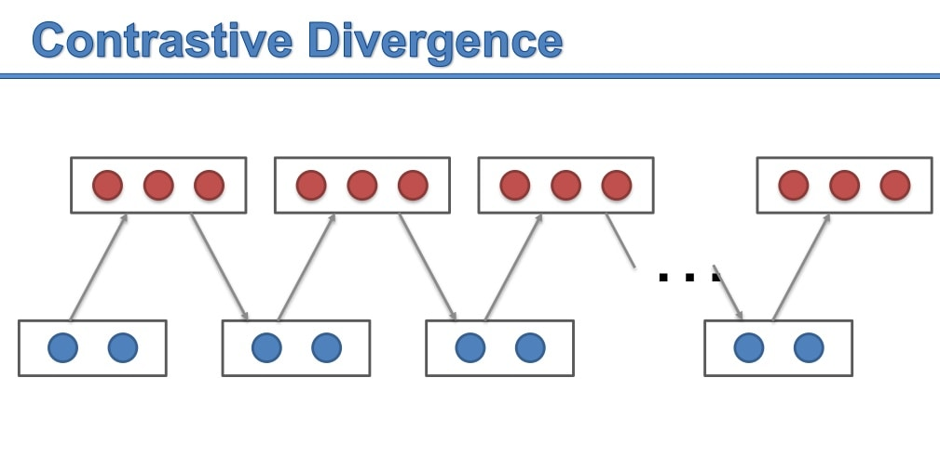

Slide 29
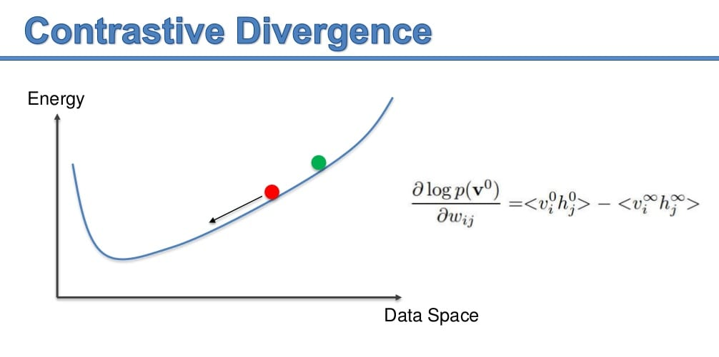

Slide 30
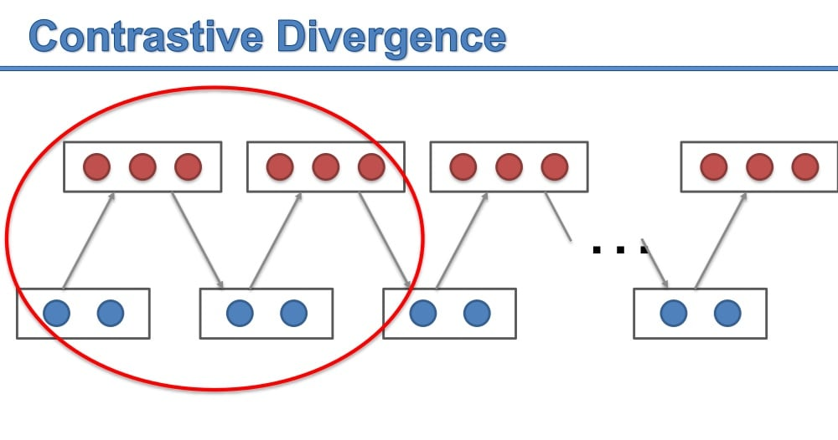

Slide 31
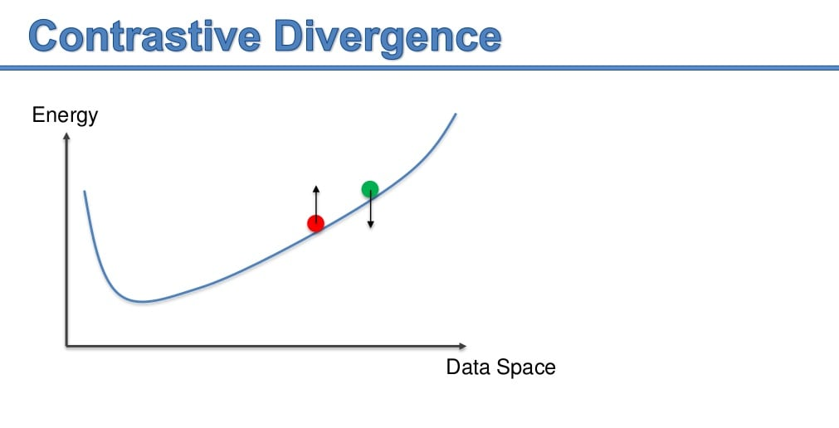

Slide 32
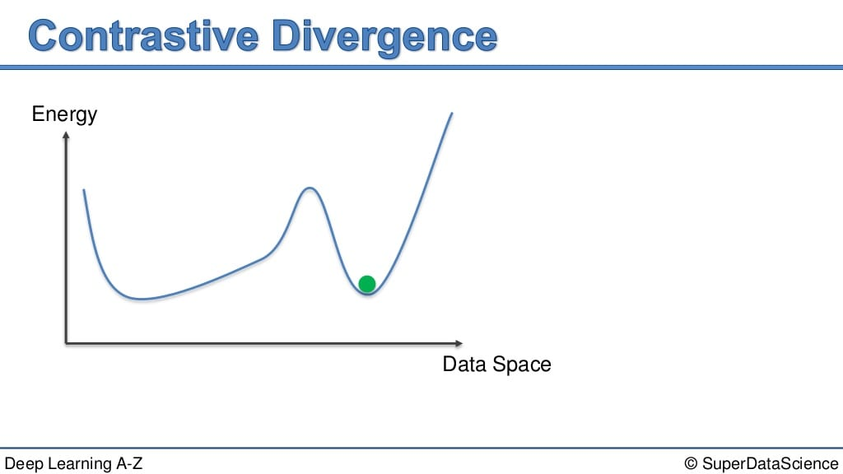

Slide 33
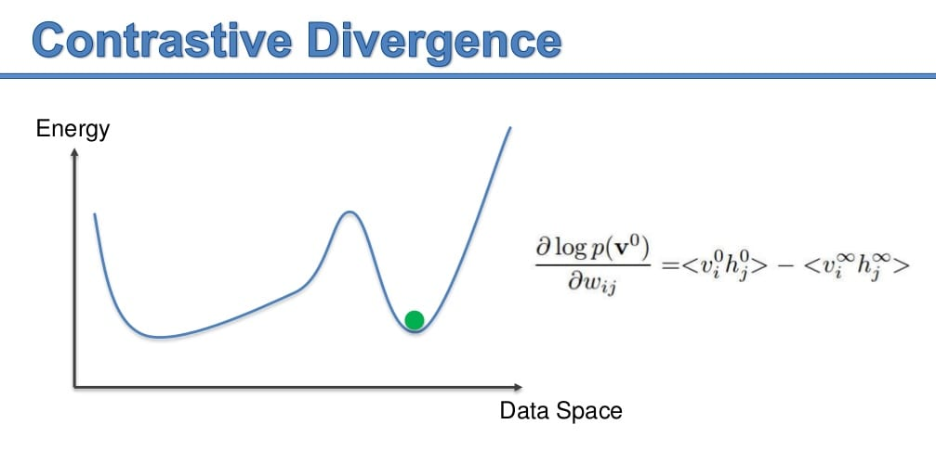

Slide 34
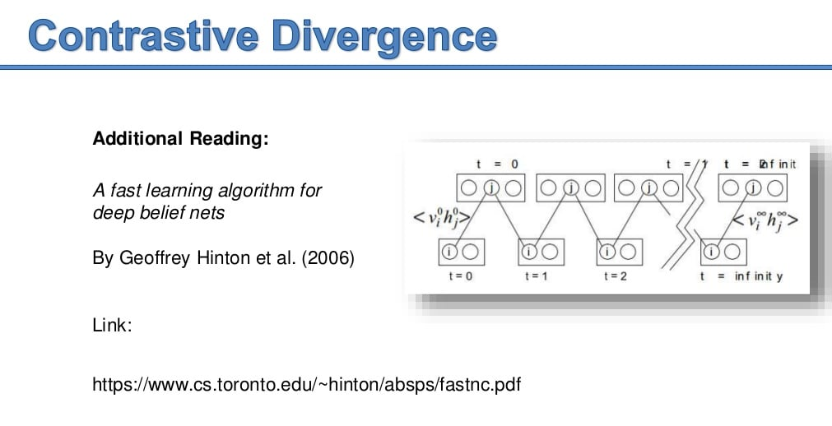

Slide 35
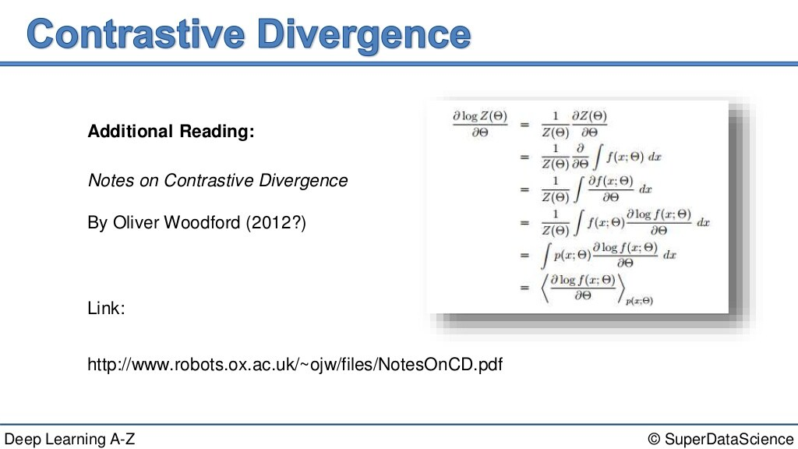

Slide 36
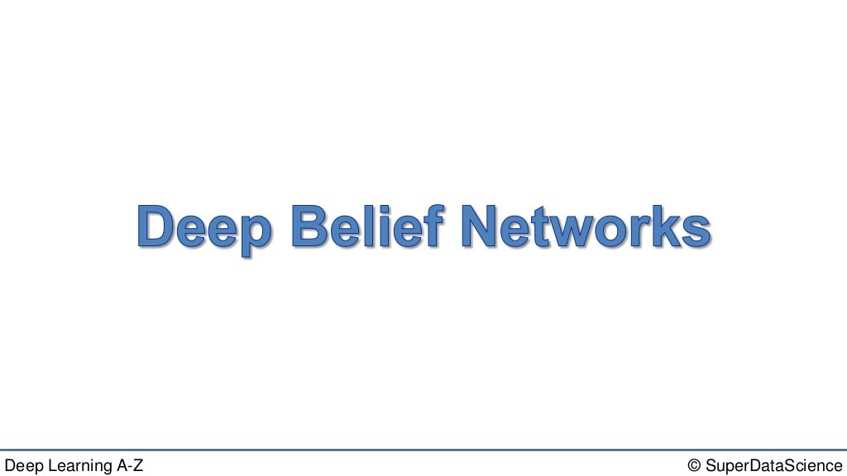

Slide 37
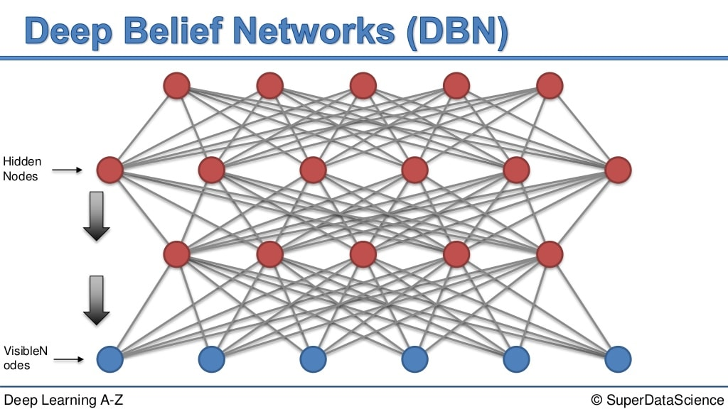

Slide 38
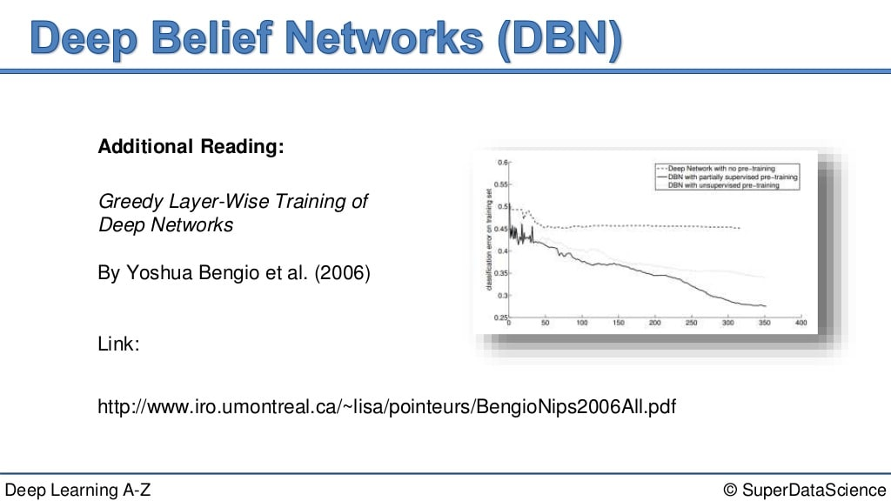

Slide 39
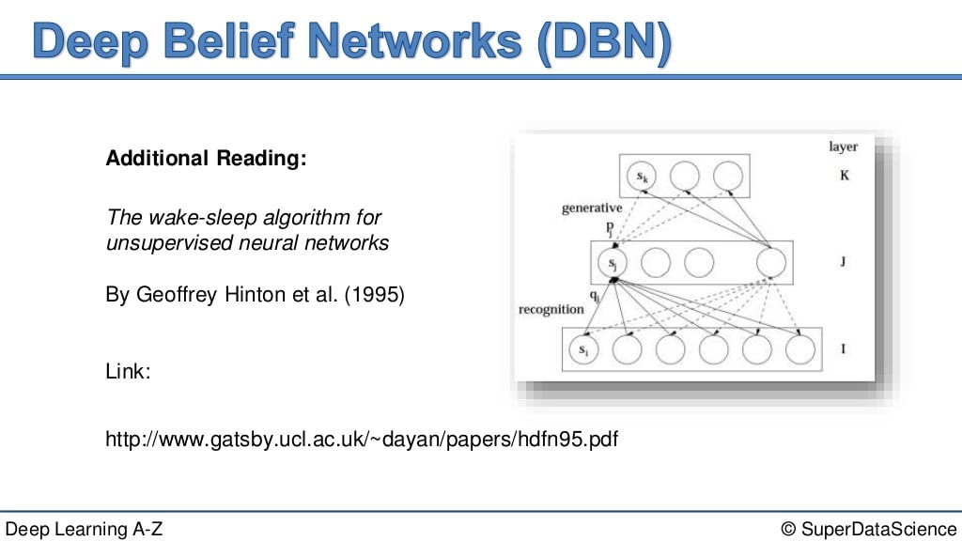

Slide 40
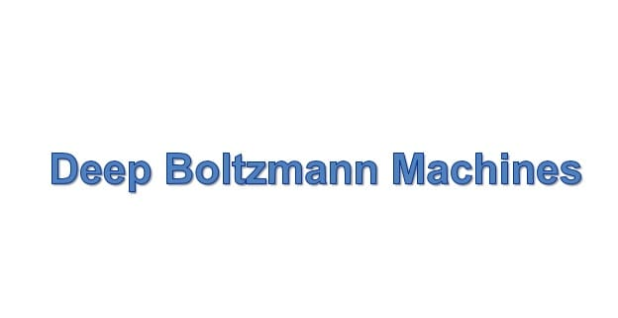

Slide 41
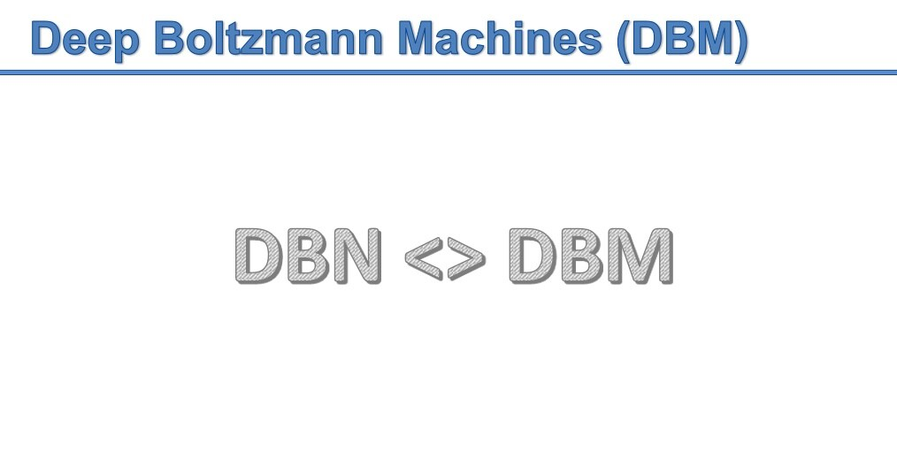

Slide 42
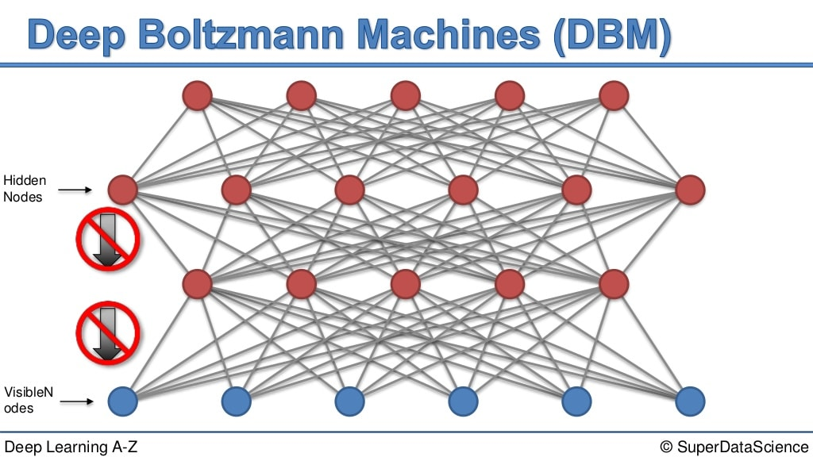

Slide 43
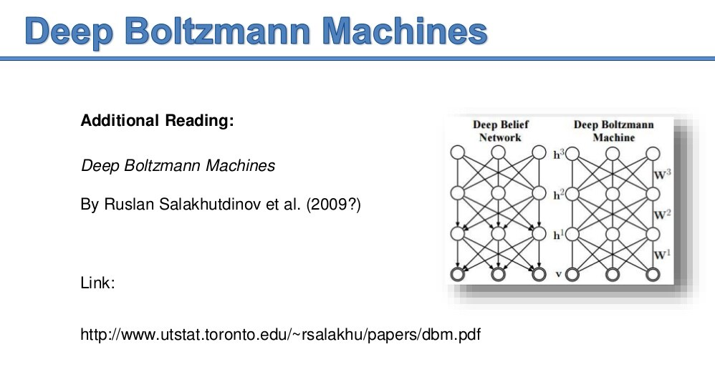

Slide 44
Interesting article
https://medium.com/machine-learning-researcher/boltzmann-machine-c2ce76d94da5 [MUST READ]
https://towardsdatascience.com/deep-learning-meets-physics-restricted-boltzmann-machines-part-i-6df5c4918c15
https://medium.com/ibm-data-ai/an-introduction-to-boltzmann-machines-with-memory-dynamic-boltzmann-machines-ffa1be82d7c2
https://medium.com/@neuralnets/boltzmann-machines-transformation-of-unsupervised-deep-learning-part-1-42659a74f530

